Slide 1
Are you ready for the tutorial?
Grab a Worksheet and instructions
Did you do the pre-work?
A. Do you have an account?
B. Have you installed the tools?
* SSH
* omni
Connect to the network
GENI Portal is at:
http://portal.geni.net

Slide 2
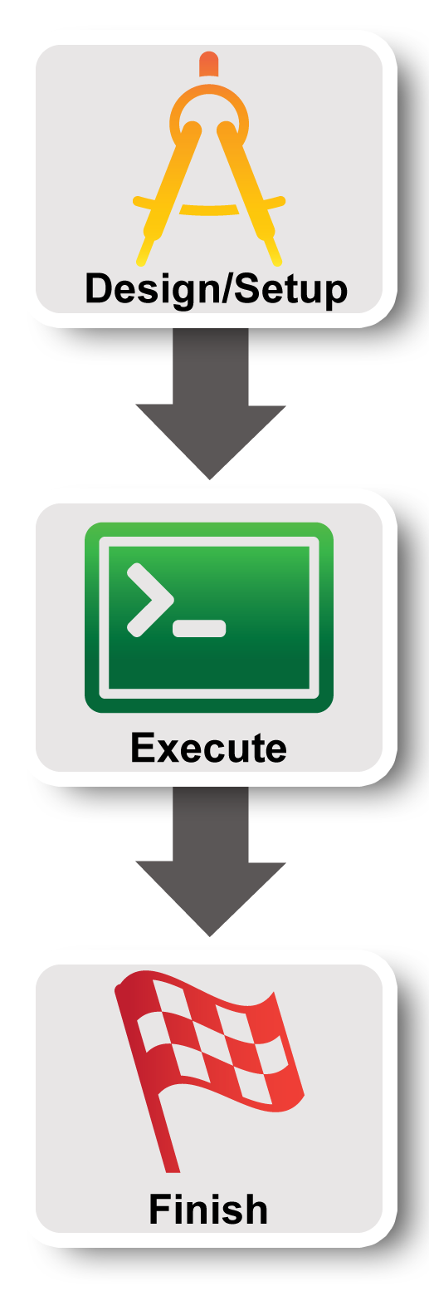
Lab Zero: A First Experiment using GENI
Sarah Edwards, GENI Project Office

Slide 3

Hands On Exercise
Do a Simple Experiment in GENI
Reserve two VMs connected at Layer 2
VM
VM
Layer 2
Notes:
There are three goals for today ….
First, jump right in and use GENI to do a very simple (layer 2) experiment

Slide 4

Use the GENI Portal and Jacks
Notes:
Third goal is to learn how to use the GENI Experimenter Portal and Flack to do this experiment in GENI.
Note that the portal and Flack are built with GENI in mind so they reflect GENI terminology and concepts.

Slide 5
Experiment Workflow
Part I: Design/Setup
Part II: Execute
Part III: Finish
Notes:
We’ve split the experiment into several parts. Before each of these sections, we’ll talk about the concepts and terms you will need for each section.
The logo on the left is intended to act as a guidepost to help you keep track of where you are.

Slide 6

The GENI Portal is…
A web-based tool for experimenters to manage experimenters, projects, and slices.
Includes simple tools to reserve resources.
More to come in the future.
Notes:
The GENI Experimenter Portal is fundamentally about managing experimenters, projects and slices (we’ll define these terms in a minute). But it also has tools for doing resource reservation.
(Note that new tools are being integrated with the Portal all the time.)

Slide 7
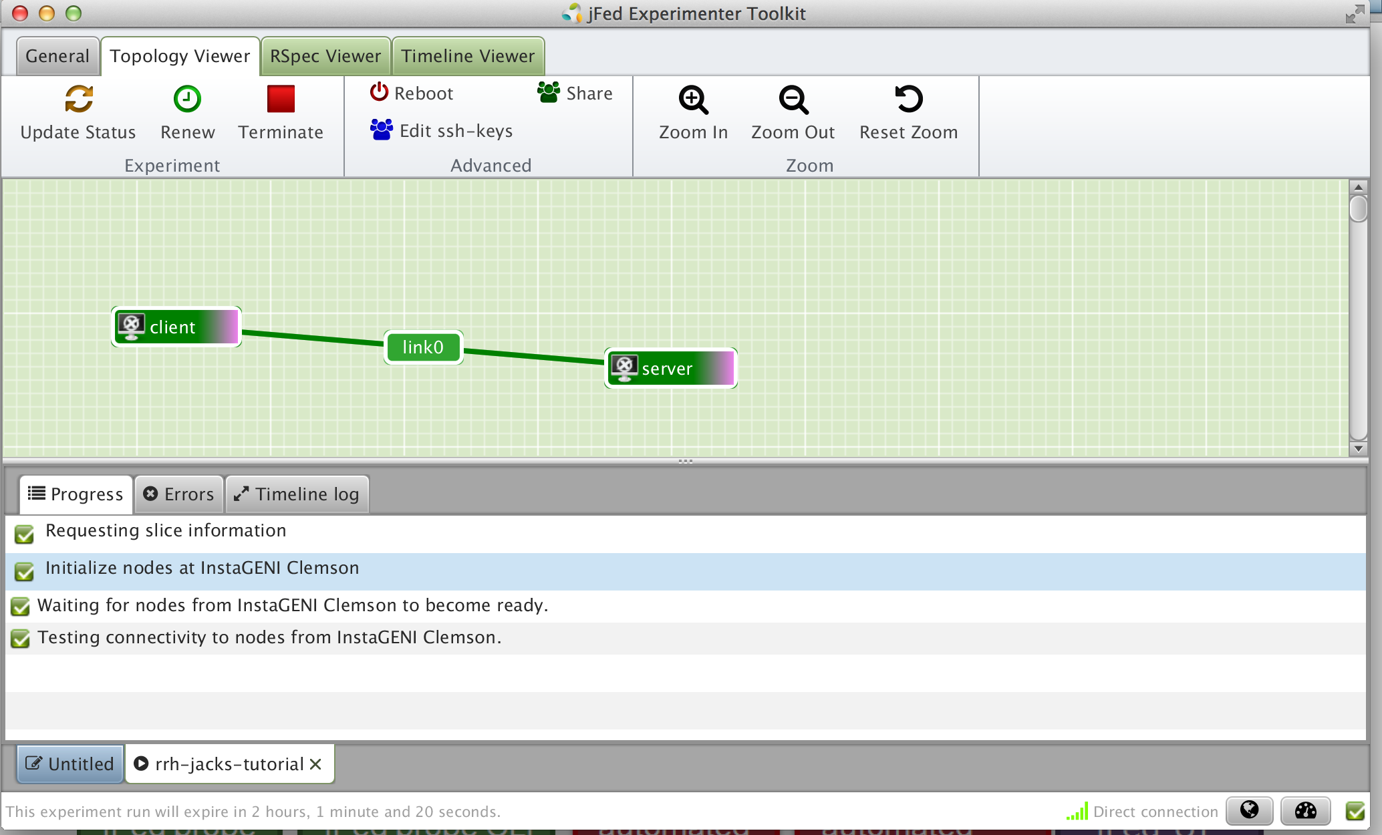
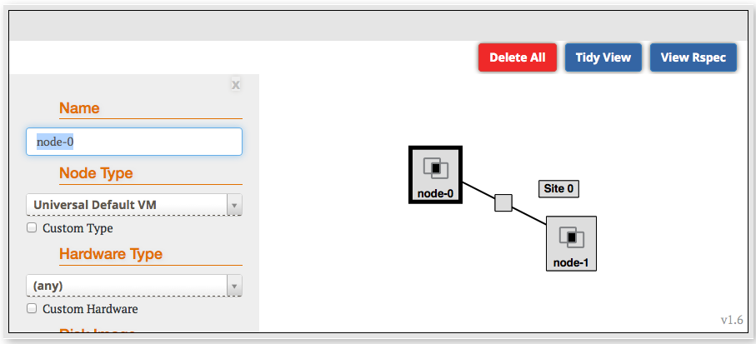
Jacks and jFed are …
Graphical user interfaces (GUIs) for:
designing topologies in GENI
reserving resources in GENI
Notes:
Jacks is a tool that is integrated into the portal which provides a graphical user interface for designing and reserving topologies in GENI.

Slide 8
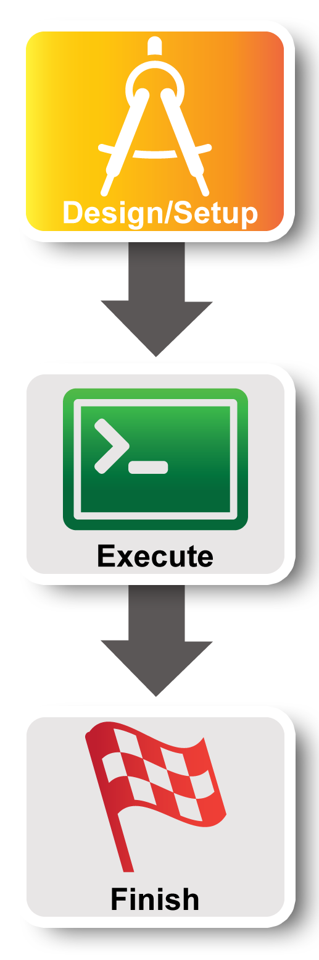
Experiment Workflow
Part I: Design/Setup
Part II: Execute
Part III: Finish
Notes:
Now we’re ready for part I. We will start by making sure we have the right access to GENI resources. This is mostly ** one-time setup **.

Slide 9
Part I: Establish Management Environment
1 Pre-work: Design your experiment
2.1 Pre-work: Create a GENI account
2.2 Pre-work: Project lead (aka Dr. Choi) adds you to project
Project Name: NA-1-Spring16Course
2.3 Generate and Download SSH Keypair
Notes:
First, if you haven’t already, we’ll log into the GENI Portal.
Second, the project lead should have already added you to a project.
Third, we will generate and download an SSH keypair.

Slide 10
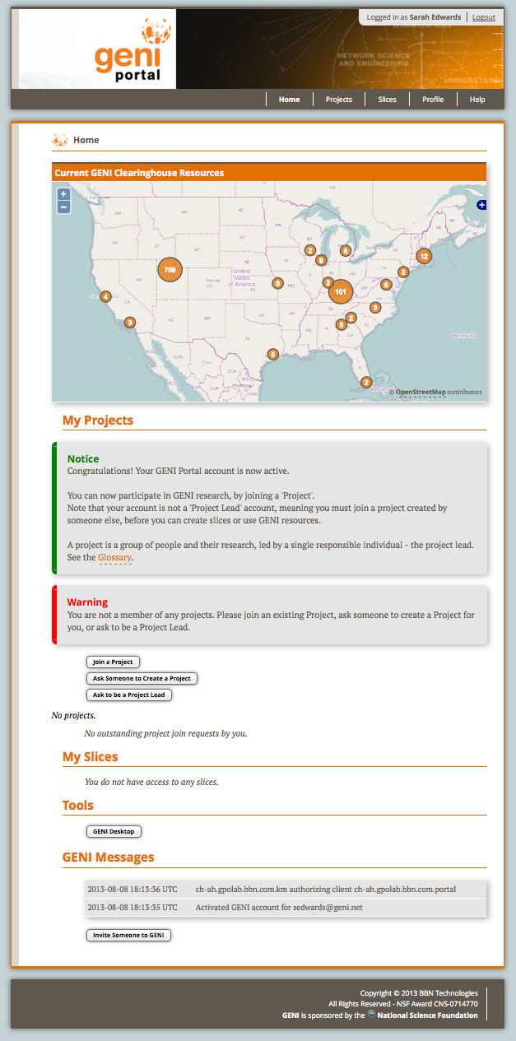
You are here
Profile
Help
Map
Projects
Slices
Tools
Log Messages
Notes:
If you haven’t already, login to the GENI Portal at https://portal.geni.net.
The Home page looks like this.
Going from top to bottom on the left, it lists all of the projects you are a member of and the slices you have. As well as a log of recent notable actions at the bottom.
The Home page has most of the features you will use day-to-day. You can always get back to the home page, by clicking “Home” in the toolbar in the upper right.
In addition the toolbar includes a Profile page which has many “occasional use” feature and a Help page with a link to a glossary and other helpful items.

Slide 11
2
Generate
SSH Keys &
SSL Certs
Login
Join Project
Notes:
You should have already logged in by now. And the tutorial leader should have added you to a project.
** If you can’t log in or aren’t in the project, please raise your hand. **
Now that everyone’s ready, please click the profile page to generate and download your SSH keys.
** Live portion: generate keys **

Slide 12
On your local machine…
2
> mv ~/Downloads/id_geni_ssh_rsa ~/.ssh/.
> chmod 600 ~/.ssh/id_geni_ssh_rsa
> ssh-add ~/.ssh/id_geni_ssh_rsa
Notes:
Download the keys generated by the portal. And configure SSH to use them.
These three commands:
* Move the private key generated by the portal into a standard location in the .ssh directory of the user’s home directory
* Changes the permissions on the file so it can’t be read by others
* Adds the ssh private key to your ssh agent.
** Live portion **

Slide 13
Part I continued: Obtain Resources
slice
VM
VM
Layer 2
3.1 Create a slice
3.2 (optional) Renew your slice
3.3 Reserve two VMs at one aggregate
3.4 Check Whether VMs are Ready to be Used
Notes:
First, we will create a slice.
Second, we will optionally renew the slice.
Third, we will reserve resources at two aggregates. There is real work happening here as the nodes are reserved.
Fourth, we’ll determine if the virtual machines have booted and are ready for use.

Slide 14
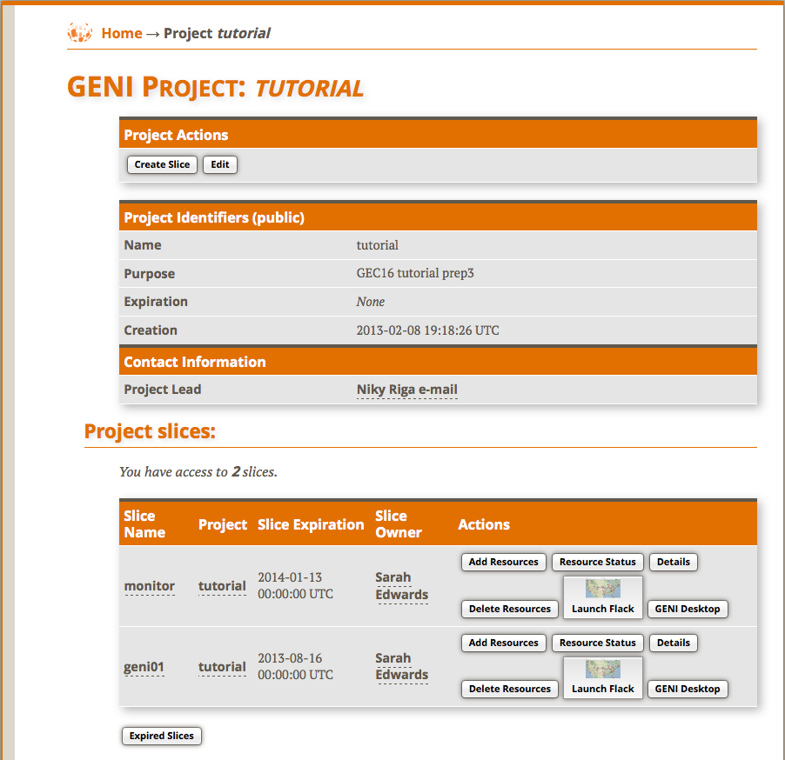
3.1
Create Slice
Notes:
Now that everyone is a member of the project, let’s click on the project page (you may need to reload your home page).
Now we all need to create a slice using the name XXXX.
** Live: create slice **

Slide 15
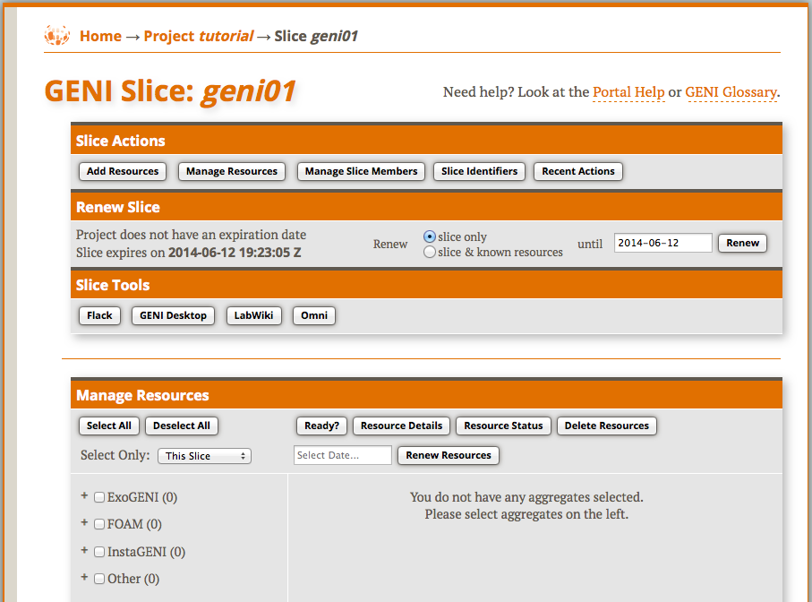
3.2
Extend slice expiration
Notes:
Next we will renew the slice to extend the initial expiration time for the resources.

Slide 16
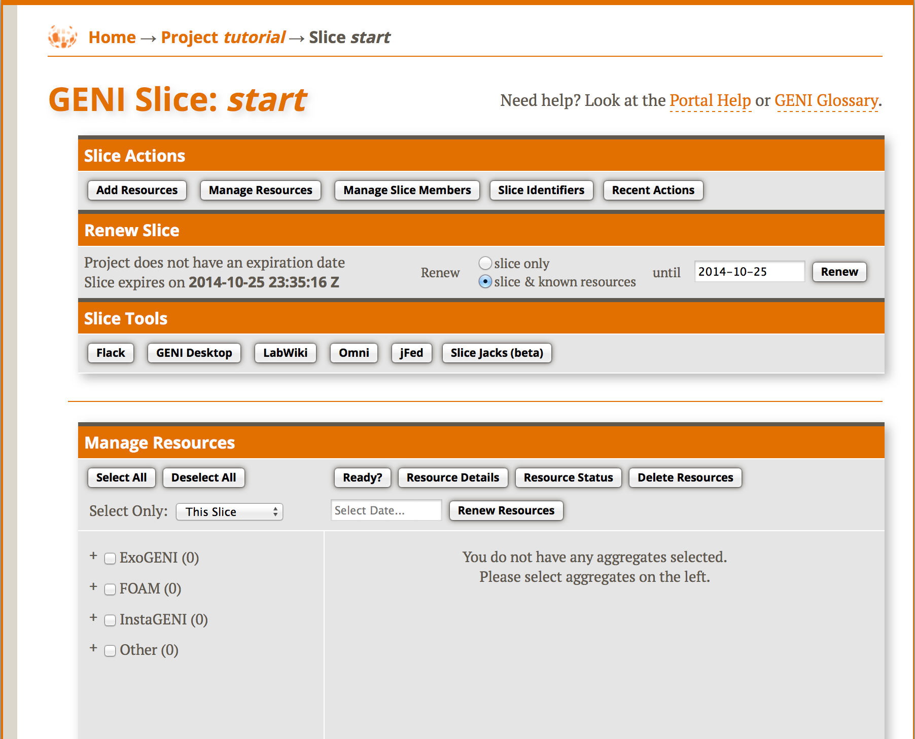
3.3
Launch
tool
Notes:
Next we will reserve resources …..
Today we will reserve resources using Flack. So let’s launch that. This may take a minute.

Slide 17
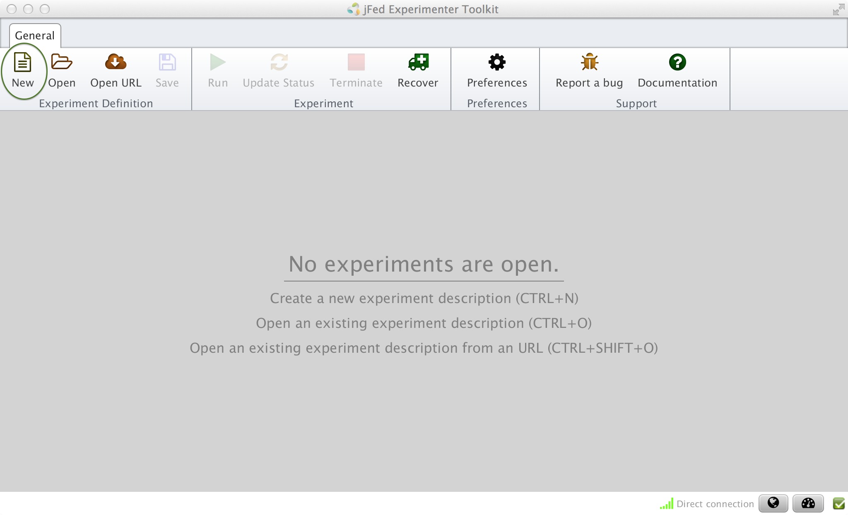
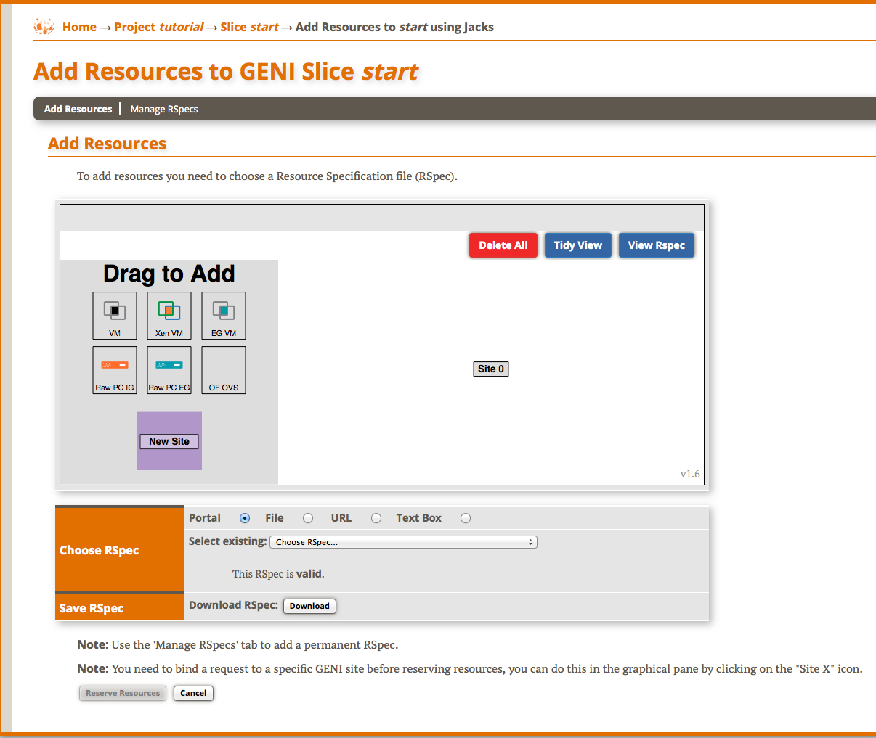
3.3
Launch
Tool
Notes:
Once Flack is loaded you should be able to see your username, slicename and a long list of aggregates.

Slide 18
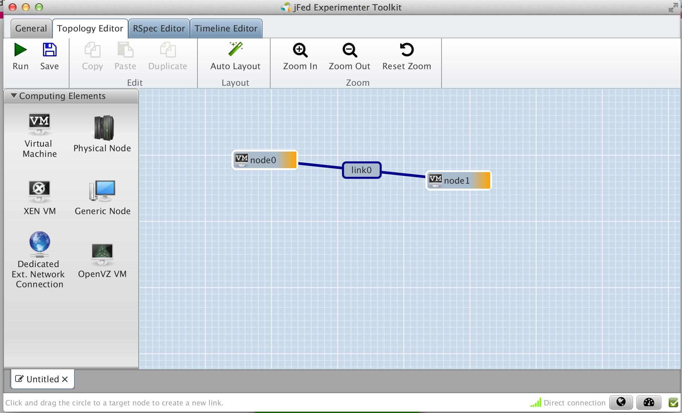
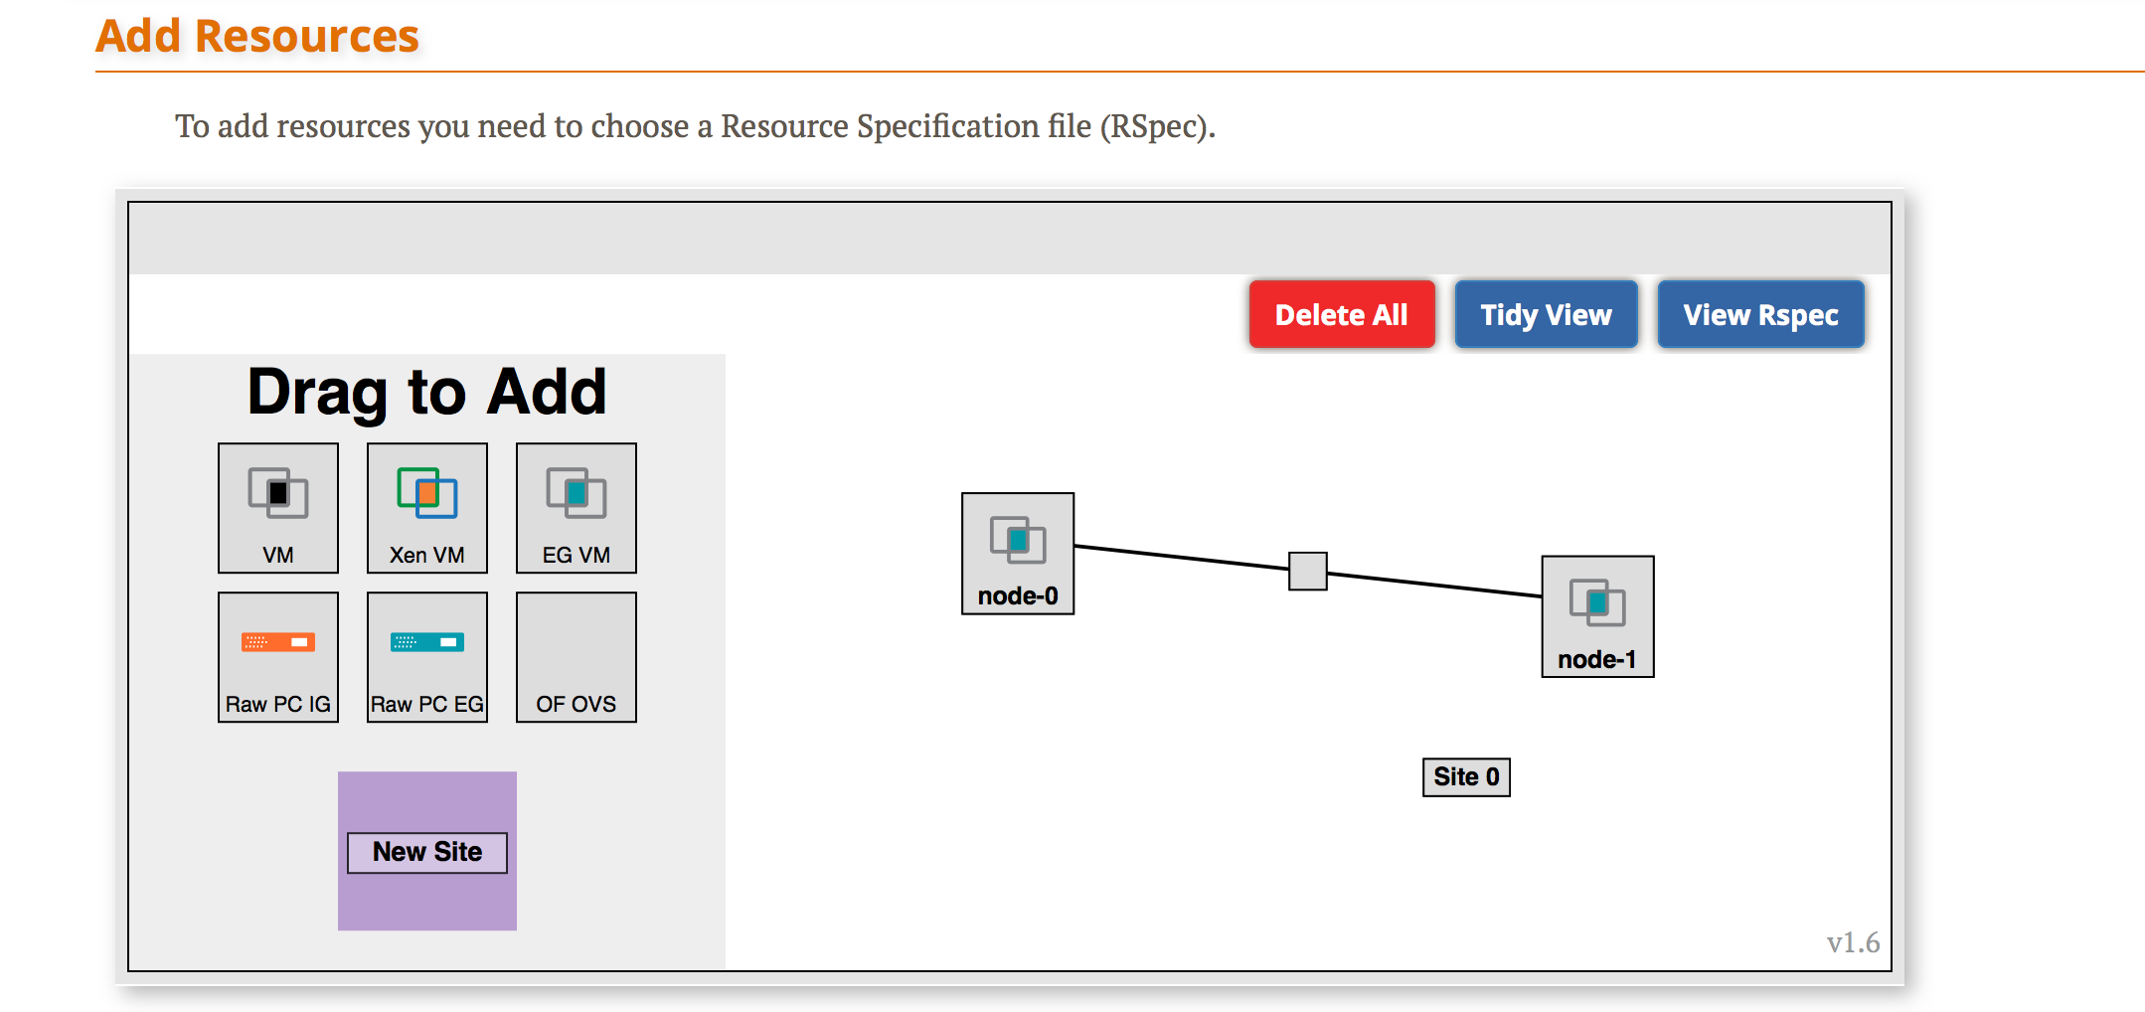
3.3
Draw two VMs connected by a link
Notes:
Find the aggregate listed on your worksheet.
Click the VM box next to that aggregate and drag it onto the canvas. Repeat.
Now click near one of the VM boxes on the canvas, then click and drag towards the other VM. Release when you reach the other VM. You should now see a line and a box representing a link connecting the two VMs.

Slide 19
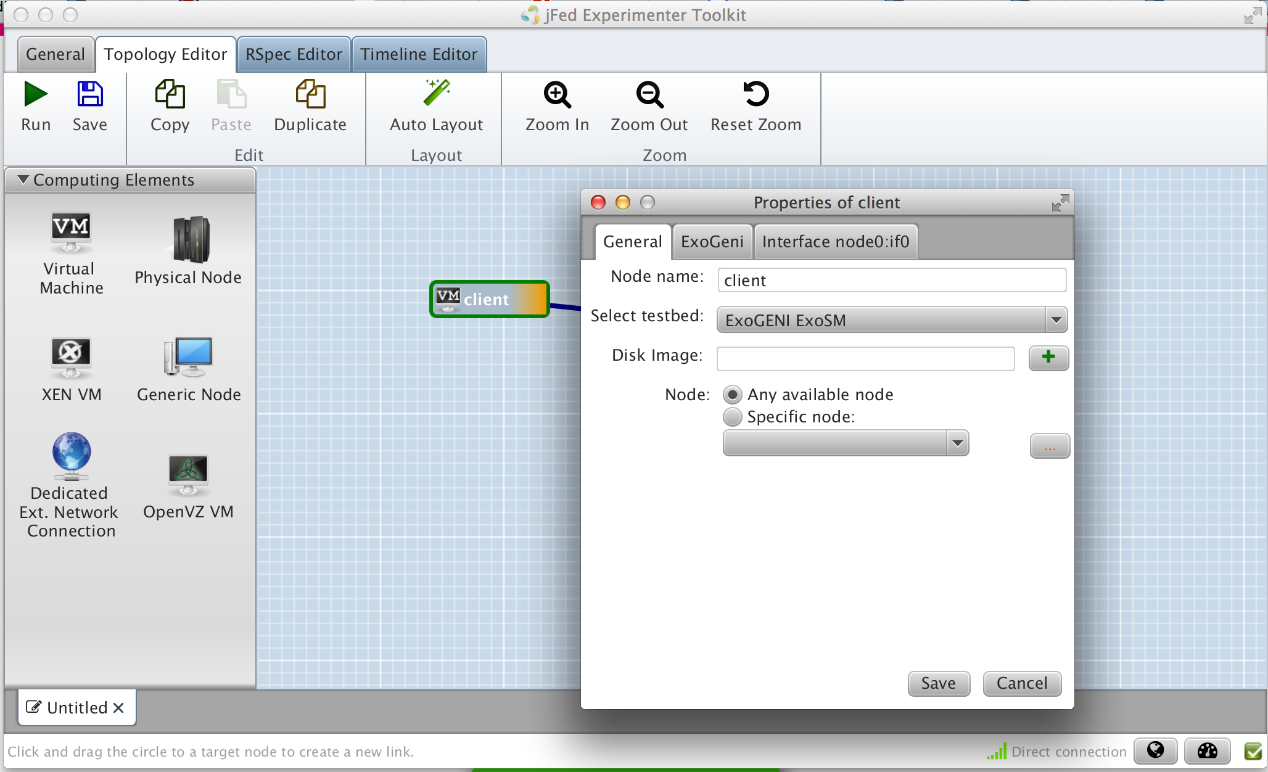

3.3
Change names of VMs
Notes:
Now change the name of the VMs by clicking on the “i” in a circle and editing the name in the pop up.
Make one VM “client” and the other “server”.

Slide 20
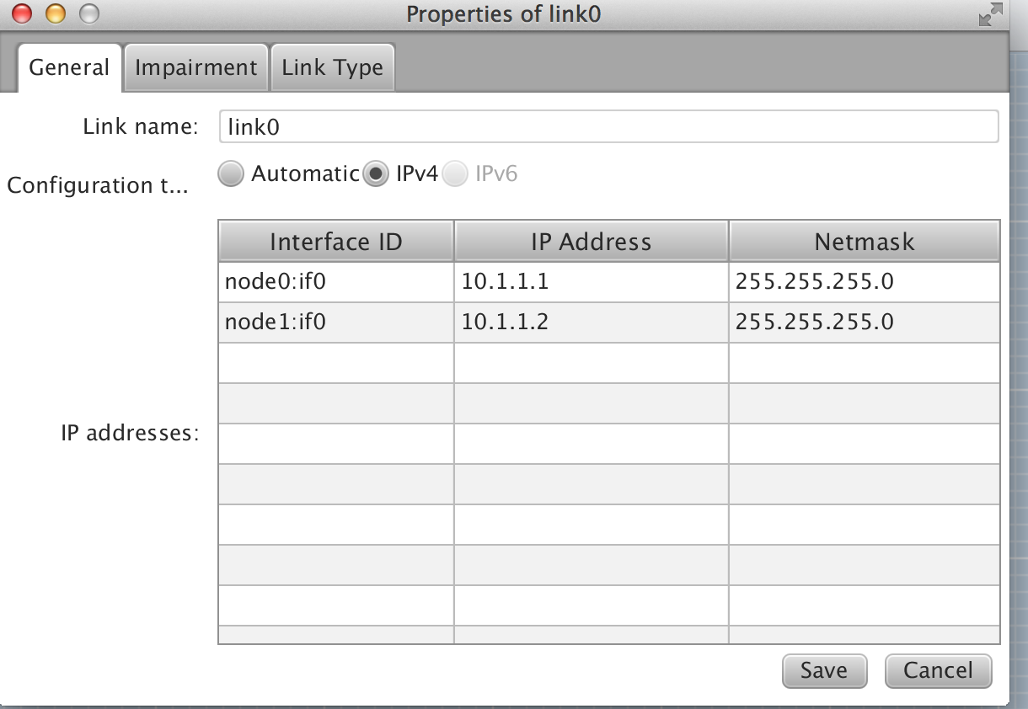
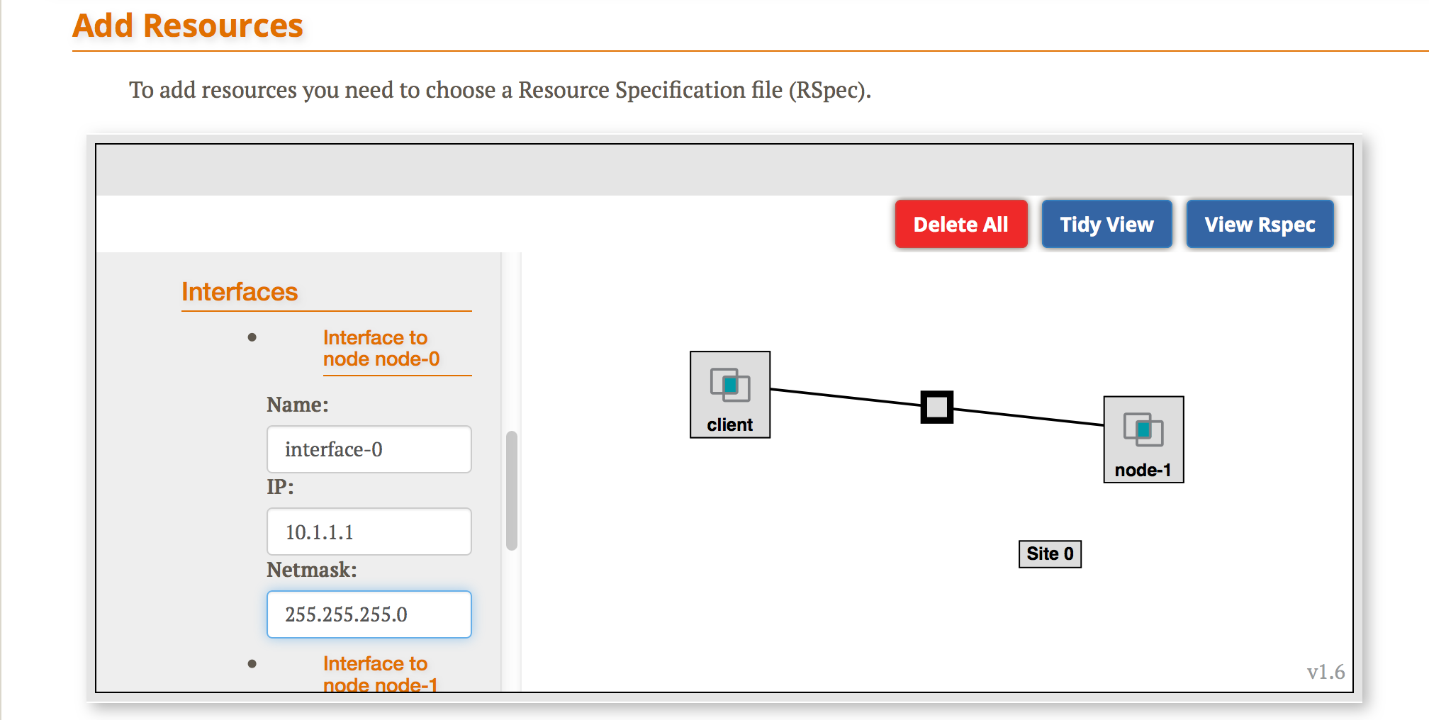
3.3
Set IP and mask of interfaces
Notes:
Now change the name of the VMs by clicking on the “i” in a circle and editing the name in the pop up.
Make one VM “client” and the other “server”.

Slide 21
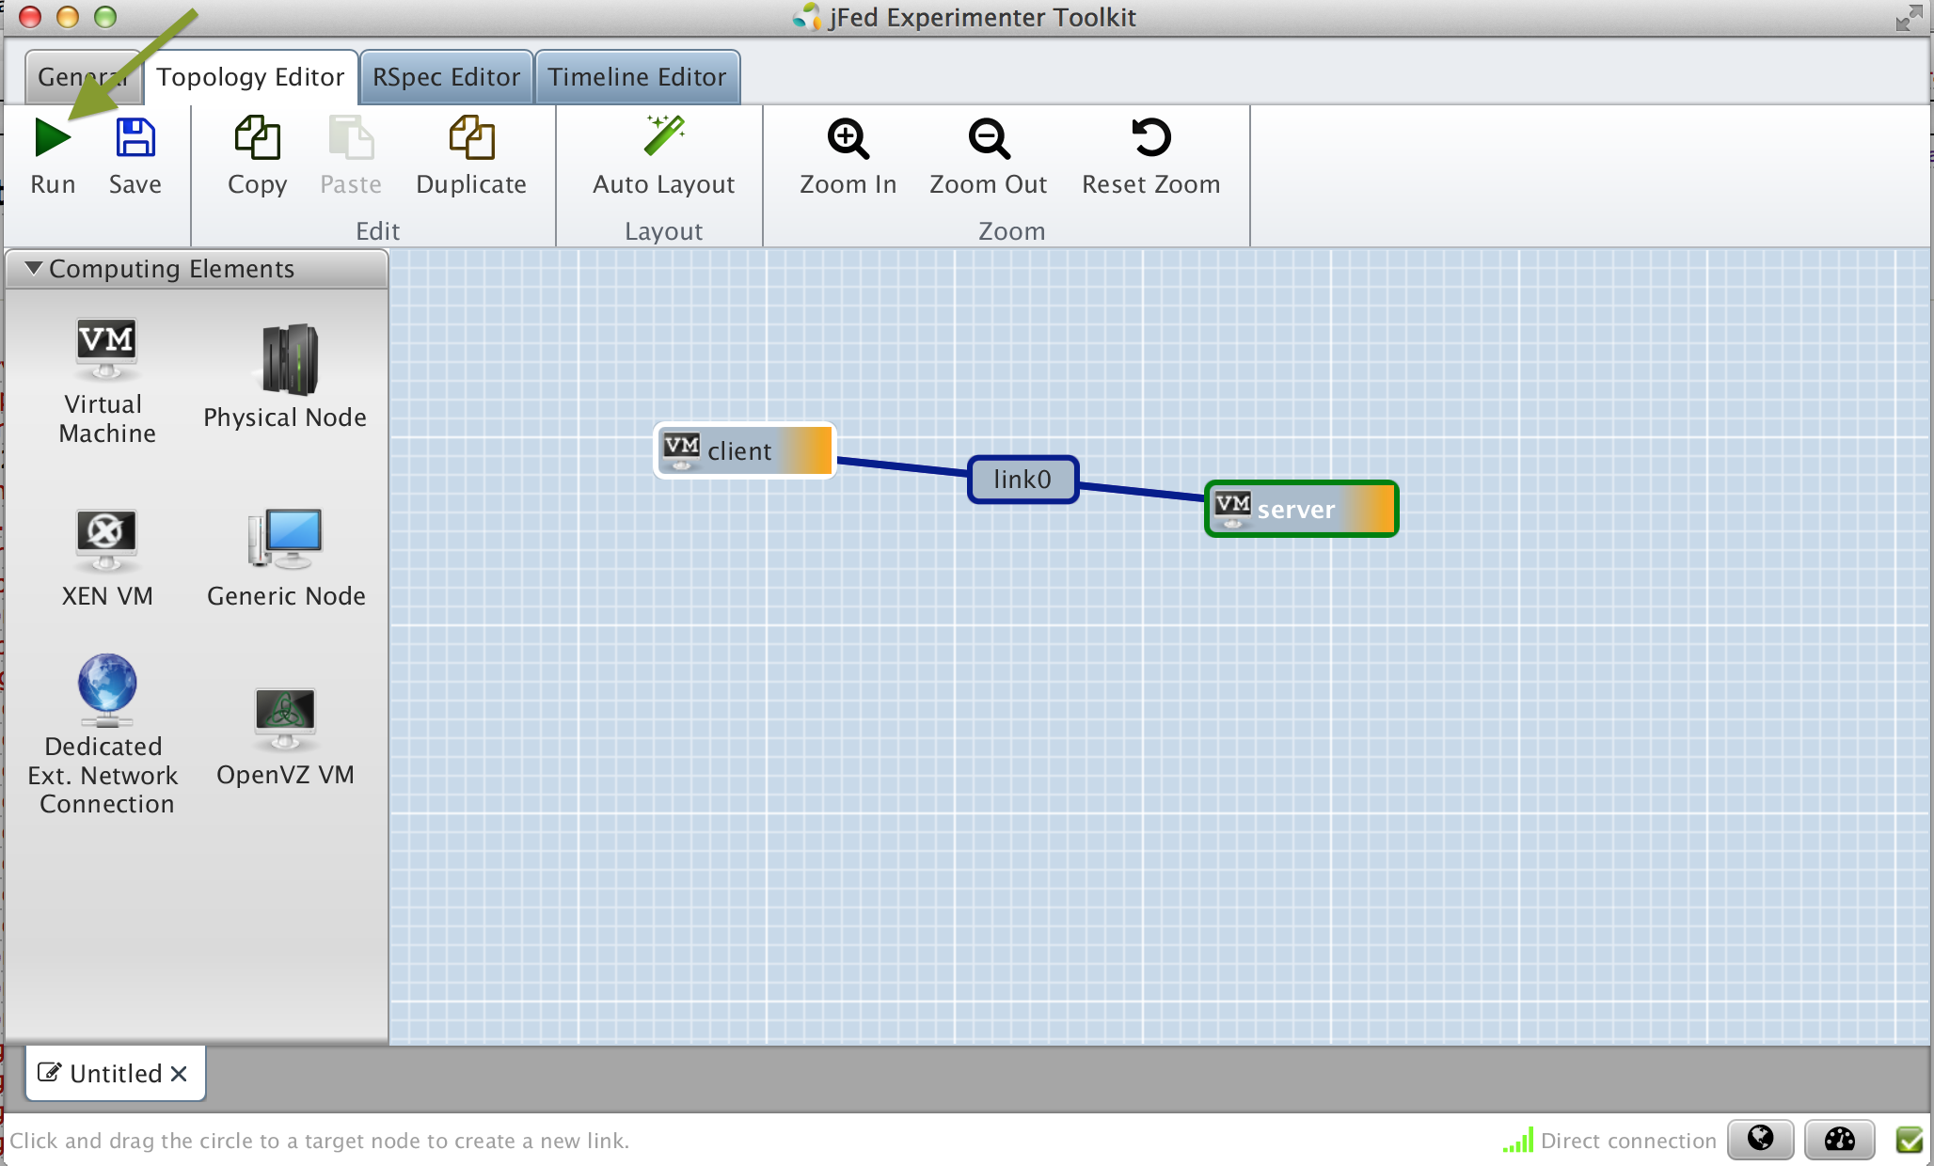
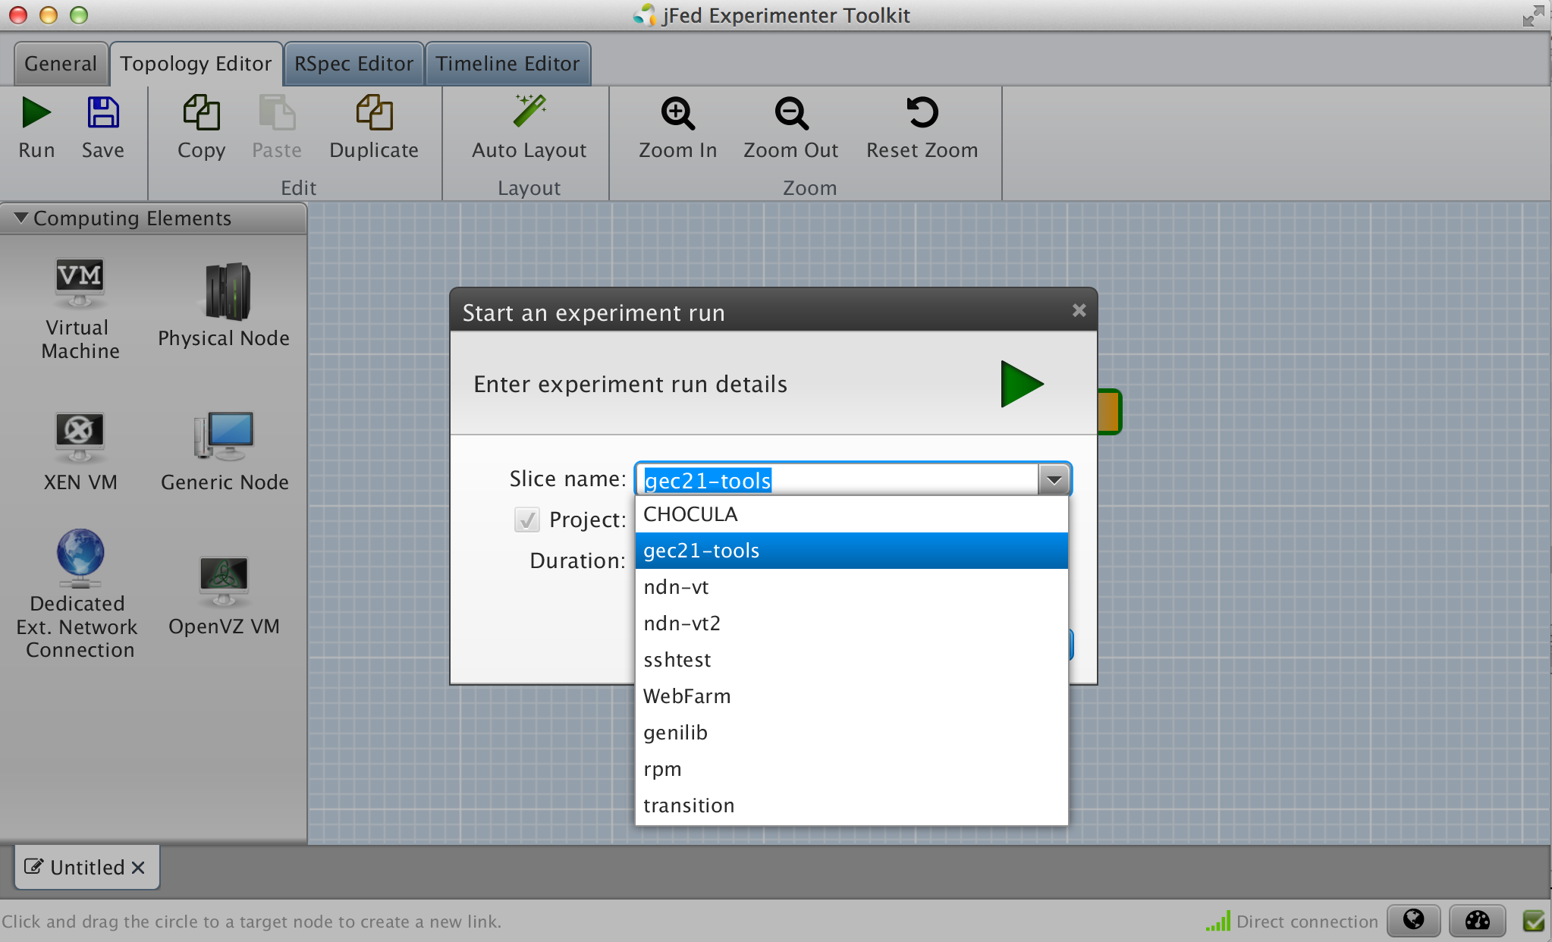
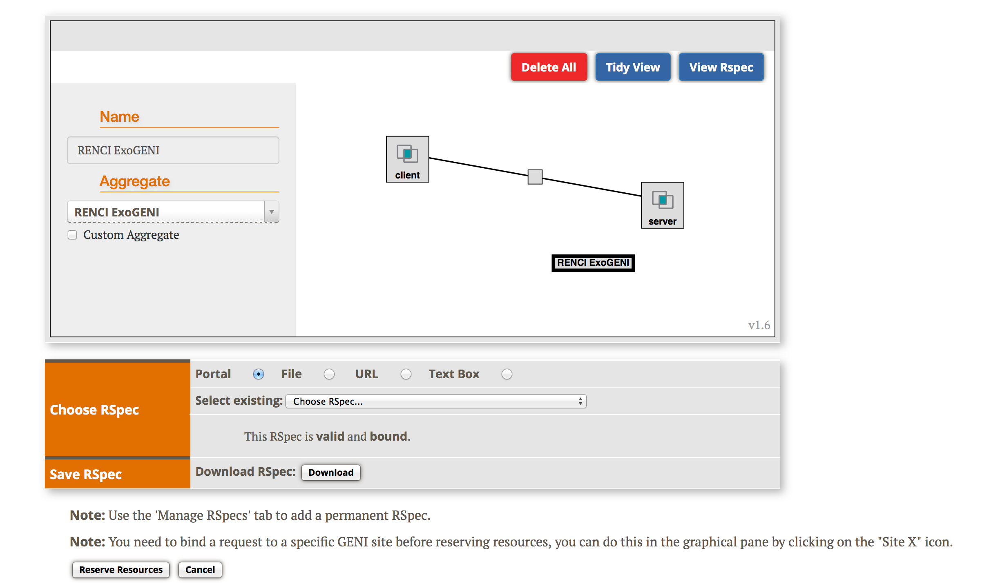
3.3
Reserve resources
Select a Slice
Bind to an Aggregate
Reserve resources
Notes:
When your topology looks like this, press the “Submit” button along the bottom.

Slide 22
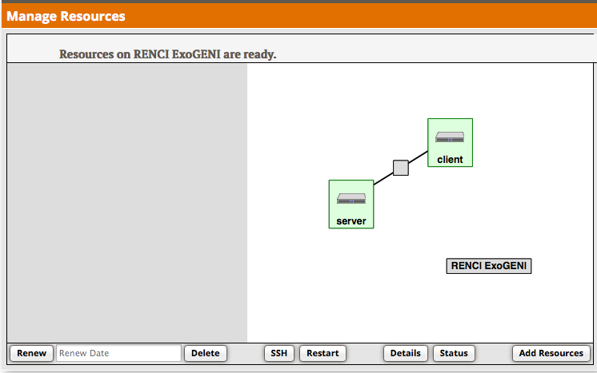
3.4
Resources are READY!!!
Notes:
After some time the background will turn green indicating that the resources are ready.

Slide 23
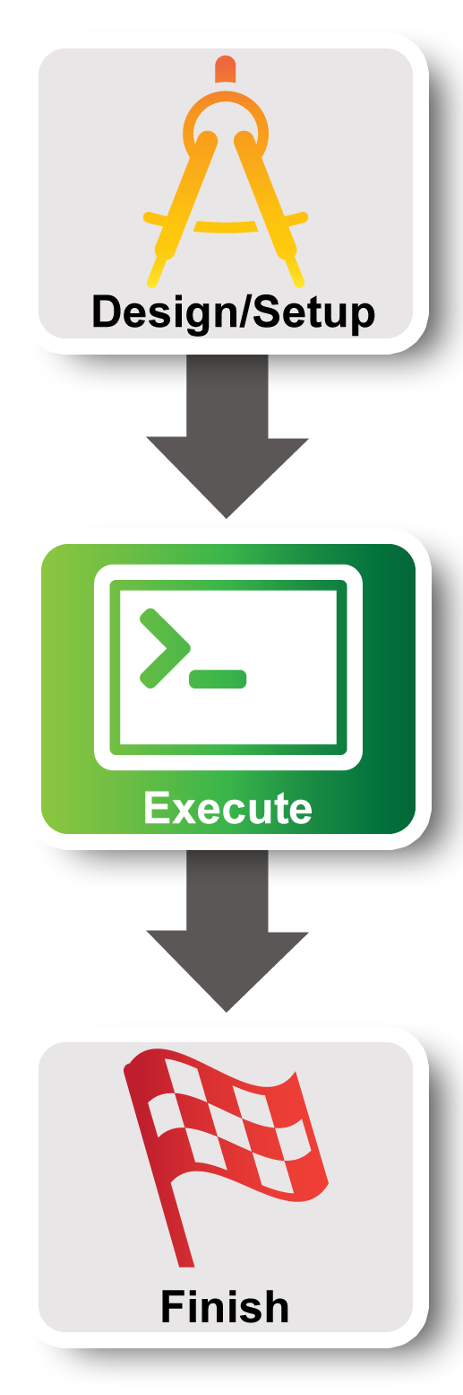
Experiment Workflow
Part I: Design/Setup
Part II: Execute
Part III: Finish
Notes:
In Part II we will execute the meat of the experiment….

Slide 24
Part II: Execute Experiment
Experimenter
Internet
ssh
Control Interfaces
client
Layer 2
server
Data Interfaces
4.1 Login to all three nodes
5.1 Test Connectivity
5.2 Explore the Data and Control Planes
6.1 Logout of nodes
Notes:
We have two nodes (“client” and “server”) and they each have two interfaces. The control interface connects to the public internet and is the interface you use to login to your nodes. The data interface is what we use for the experiment: it’s connected to the VLAN.
We will log into our nodes.
Then we will run our experiment ….
When we are done we’ll log out.

Slide 25
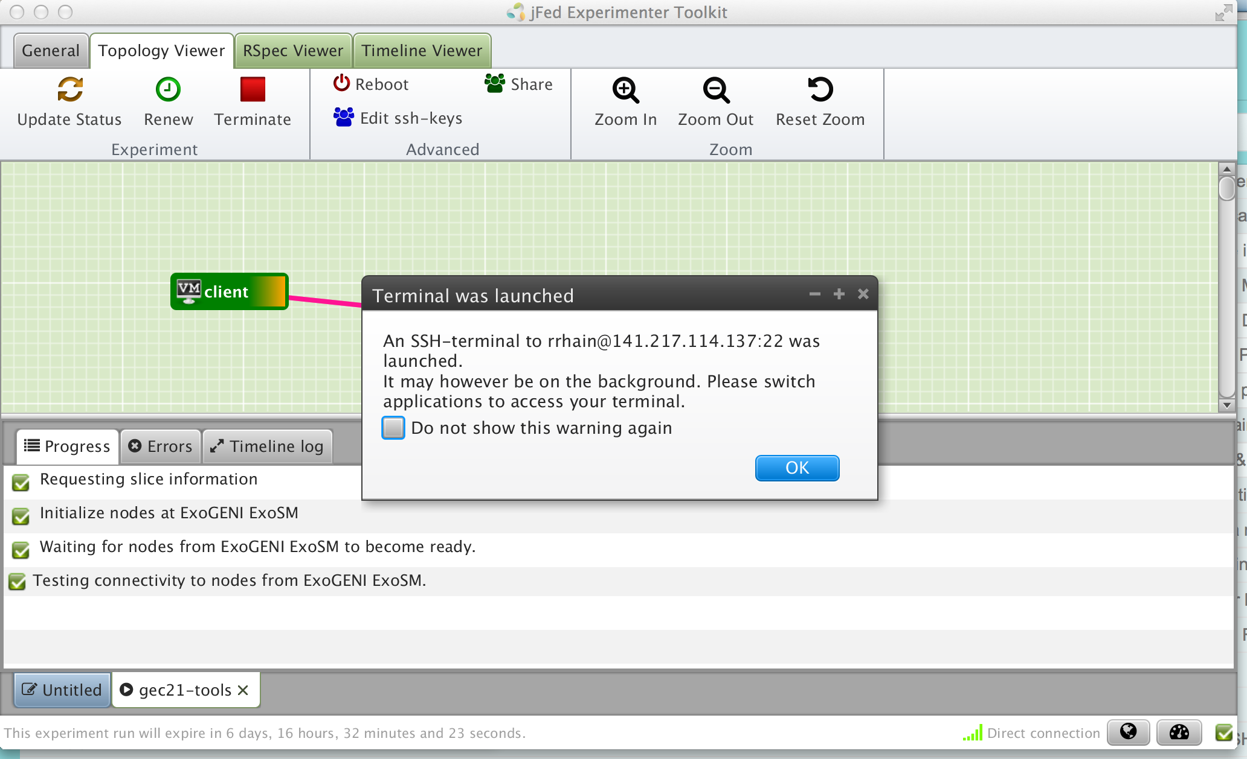
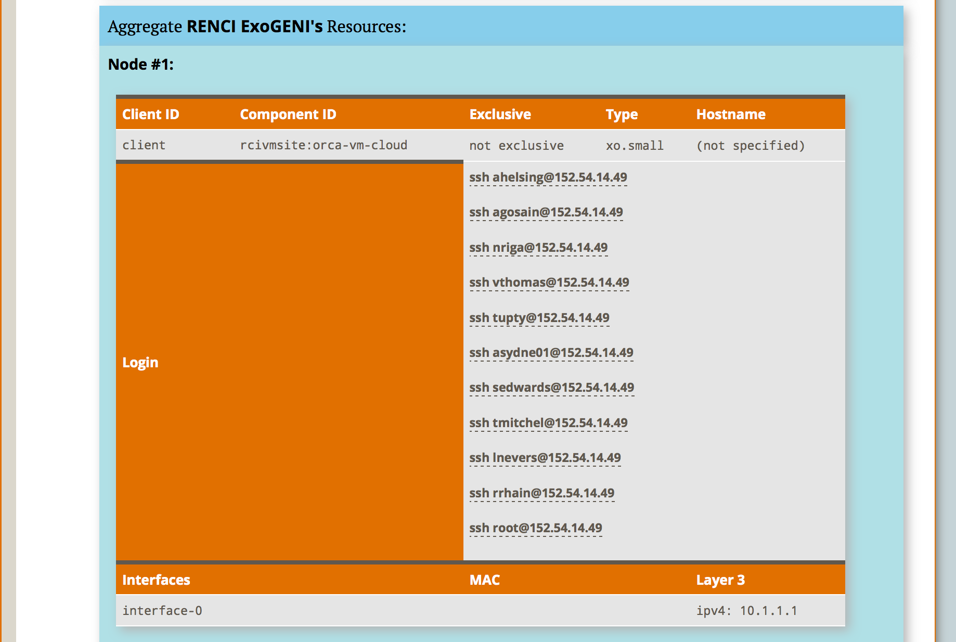
4.1
Login
Notes:
Click on the ssh command to login.
Those using ExoGENI, will need to click the “refresh” button (at the bottom near the Submit) button to get the ssh button to show up.

Slide 26
5.1
$ sudo ifconfig
$ ping 192.168.1.11 –c 5 # server data i/f
$ ping 172.17.1.9 –c 5 # server ctrl i/f
NodeA
5.1
$ sudo ifconfig
NodeB/
NodeC
Notes:
log into your two VMs
Next run ifconfig….
STOP and ….

Slide 27
Worksheet
5.1
Slice Name: lab0<your initials>
Internet
Control plane switch
eth___
___.___.___.___
eth___
___.___.___.___
NodeA
Data plane switch
NodeB
Control i/f
Control i/f
Data i/f
eth___
Data i/f
eth___
10.1.1.1
10.1.1.2
GENI Rack
Notes:
… fill in your worksheet. This is really important.
Be careful.
** Live portion **

Slide 28
$ sudo apt-get install iperf
$ hash
# server data i/f
$ iperf –c 192.168.1.11
…
# server ctrl i/f
$ iperf –c 172.17.2.4
…
5.1
$ sudo apt-get install iperf
$ hash
# start an iperf server
$ iperf -s
NodeA
NodeB
Notes:
Ping the server’s data interface. This should succeed. Let us know if this doesn’t work and we’ll help you debug it.
Ping the server’s control interface. This should also succeed.

Slide 29
What is the bandwidth of the data link? Why?
What is the bandwidth of the control link? Why?
5.1
Internet
Control plane switch
eth___
___.___.___.___
eth___
___.___.___.___
NodeA
Data plane switch
NodeB
Control i/f
Control i/f
Data i/f
eth___
Data i/f
eth___
10.1.1.1
10.1.1.2
GENI Rack
Notes:
What is the bandwidth of the data link? Why?
The bandwidth of the data link is about 100 Mbps which is the default.
What is the bandwidth of the control link? Why?
A lot more. Because you get the full available link.

Slide 30

# ping server data i/f
$ ping 192.168.1.11
…
# ping server ctrl i/f
$ ping 172.17.2.4
…
$ exit
5.3
# For ExoGENI only do:
$ sudo service neuca stop
# bring down data i/f
$ sudo ifconfig eth12541 down
# bring down ctrl i/f
$ sudo ifconfig eth999 down
5.3
NodeA
NodeB
Notes:
Ping the server’s data interface. This should succeed.
Next bring down the data interface on the server node.
Your pings should start to fail.
Ping the server’s control interface. This should succeed.
Next bring down the control interface on the server node.
Your ssh connection to the server node should immediately hang.
And your pings should start to fail.

Slide 31
5.3
When you bring down the data interface, the destination should become unreachable. Why?
Internet
Control plane switch
eth___
___.___.___.___
eth___
___.___.___.___
NodeA
Data plane switch
NodeB
Control i/f
Control i/f
Data i/f
eth___
Data i/f
eth___
10.1.1.1
10.1.1.2
GENI Rack
Notes:
When you bring down the data interface, the destination should become unreachable.
Why?
The client can no longer reach that interface on the server.
After you bring down the control interface, your ssh session should immediately hang.
Why?
You brought down the interface you were using to log into the node.
After you bring down the control interface, the destination should become unreachable.
Why?
The client can no longer reach that interface on the server.

Slide 32
5.3
After you bring down the control interface, the destination becomes unreachable. Why?
Internet
Control plane switch
eth___
___.___.___.___
eth___
___.___.___.___
NodeA
Data plane switch
NodeB
Control i/f
Control i/f
Data i/f
eth___
Data i/f
eth___
10.1.1.1
10.1.1.2
GENI Rack
Notes:
When you bring down the data interface, the destination should become unreachable.
Why?
The client can no longer reach that interface on the server.
After you bring down the control interface, your ssh session should immediately hang.
Why?
You brought down the interface you were using to log into the node.
After you bring down the control interface, the destination should become unreachable.
Why?
The client can no longer reach that interface on the server.

Slide 33
5.3
After you bring down the control interface, your ssh session should immediately hang. Why?
Internet
Control plane switch
eth___
___.___.___.___
eth___
___.___.___.___
NodeA
Data plane switch
NodeB
Control i/f
Control i/f
Data i/f
eth___
Data i/f
eth___
10.1.1.1
10.1.1.2
GENI Rack
Notes:
When you bring down the data interface, the destination should become unreachable.
Why?
The client can no longer reach that interface on the server.
After you bring down the control interface, your ssh session should immediately hang.
Why?
You brought down the interface you were using to log into the node.
After you bring down the control interface, the destination should become unreachable.
Why?
The client can no longer reach that interface on the server.

Slide 34
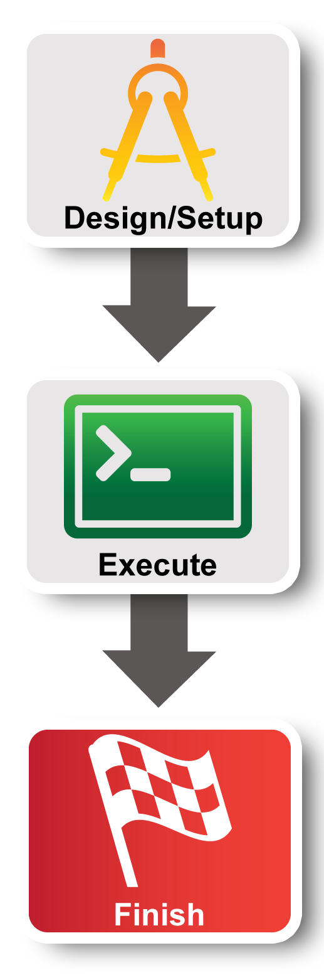
Experiment Workflow
Part I: Design/Setup
Part II: Execute
Part III: Finish
Notes:
The third part of the experiment is when you would normally archive any data and release your resources.

Slide 35
Finish
Don’t Delete YET!!!
We will clean up later

Slide 36
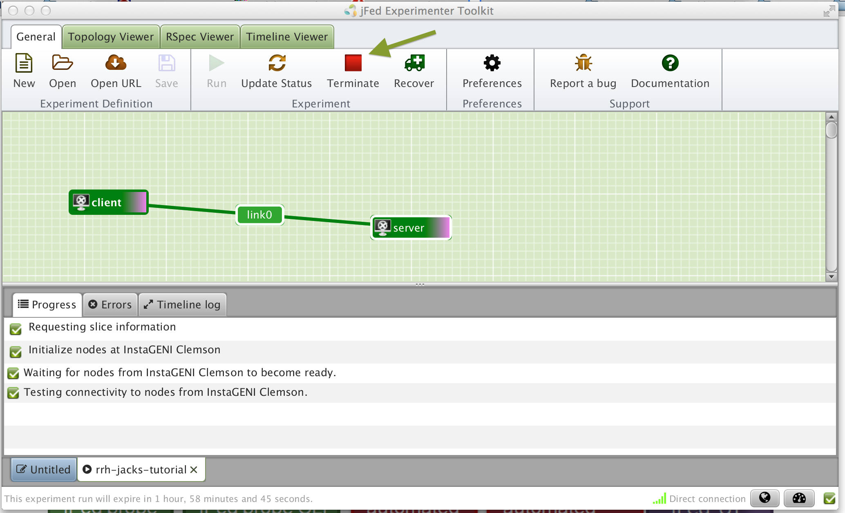
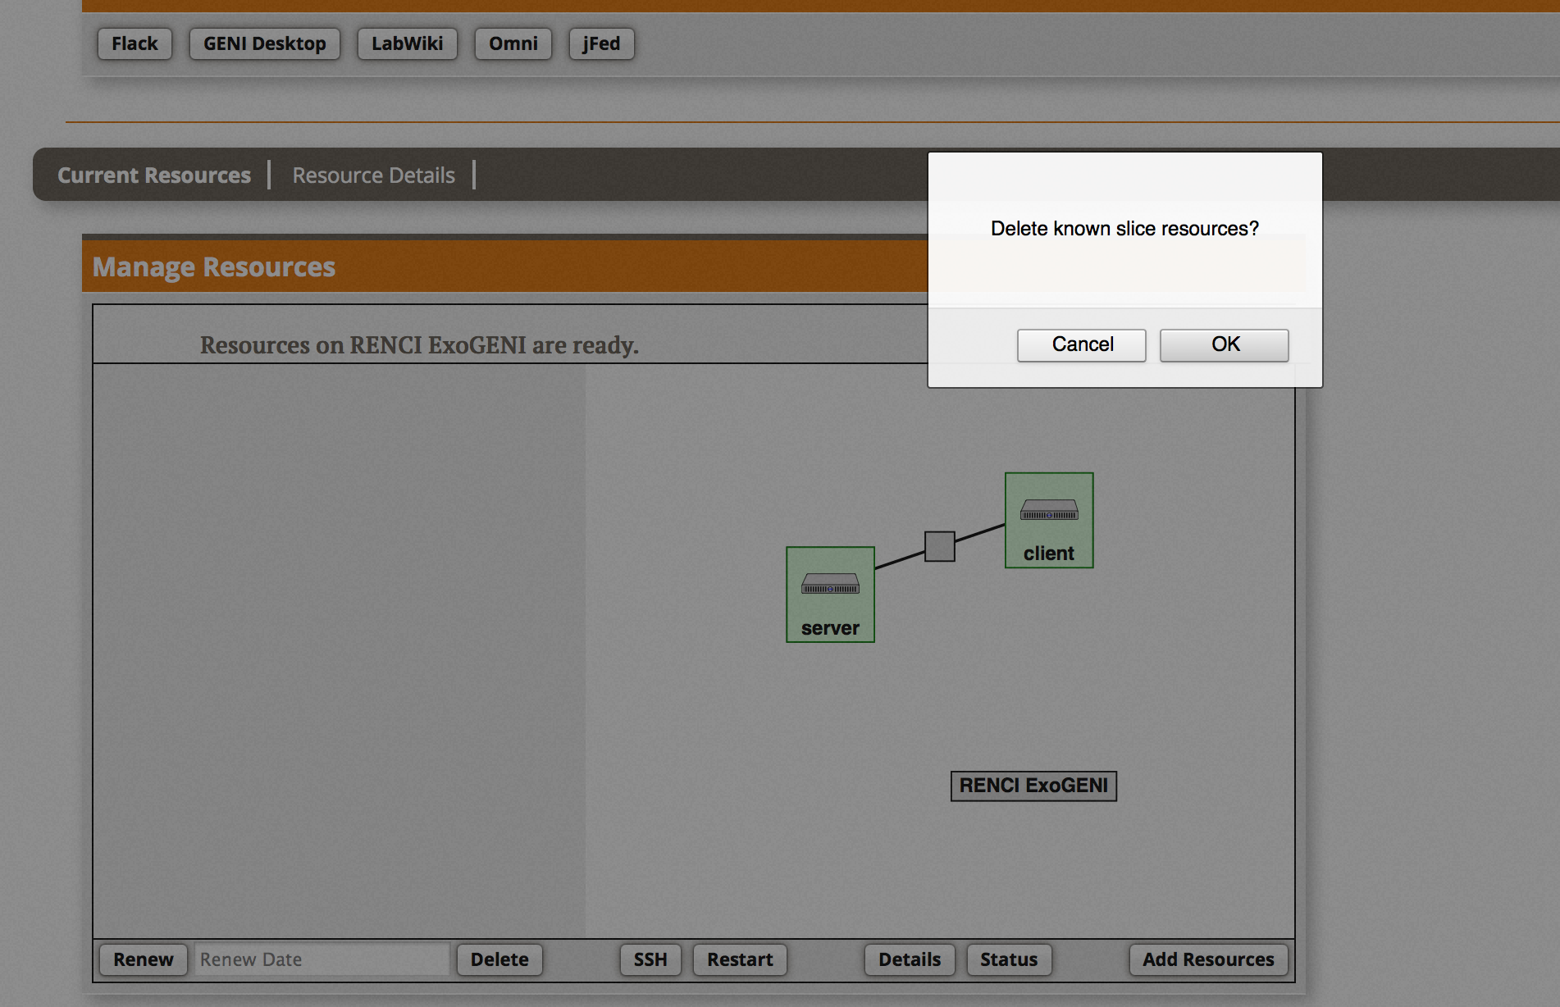
7
Delete Resources
Notes:
The delete button is on the bottom of Flack (above the Submit button).

Slide 37

Part III: Finish Experiment
project
resource
experimenter
aggregate
slice
When your experiment is done, you should always release your resources.
Normally this is when you would archive your data
Delete your resources at each aggregate
Notes:
Be sure to delete your resources.

Slide 38
Congratulations!
You have…
Run your first GENI Experiment!
Exercised your knowledge of GENI terminology
Used the GENI Portal and Jacks or jFed
Notes:
When we started, we promised to do three things.
You’ve run your first GENI experiment.
You’ve hopefully developed a more concrete understanding of GENI terminology.
You have used the GENI portal and Flack

Slide 39
Welcome
to GENI!

Slide 40
Internet
Control plane switch
eth___
___.___.___.___
eth___
___.___.___.___
NodeA
Data plane switch
NodeB
Control i/f
Control i/f
Data i/f
eth___
Data i/f
eth___
192.168.1.10
192.168.1.11
GENI Rack

